Slide 1
Blockchain Technology
M Mohaiminul Islam

Slide 2
Why should I study Blockchain
The core reason for studying blockchain is,it’s a disruptive technology. It means it will change the traditional approach to a new enhanced version.
Like how the internet changed the total communication system, Blockchain technology changed the trust ecosystem. Internet gave us everything ,smooth our communication system but the major problem with the internet is that the trust issue. With the help of blockchain we can resolve this trust issue.

Slide 3
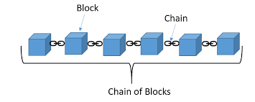
What is blockchain
´First, this idea came from a 1991’s research paper named “how to timestamp a digital document”.stuart Haber and W.scott stornetta published this paper. And later on, in 2008, satasi Nakamoto invented bitcoin using this blockchain technology.
Alert: Don’t confuse between blockchain and bitcoin. Both are totally diff.
Blockchain is a distributed ,immutable ledger which is completely transparent and it’s a decentralized system.

Slide 4
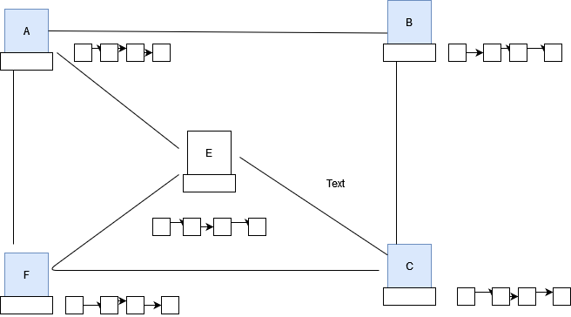
Con.

Slide 5
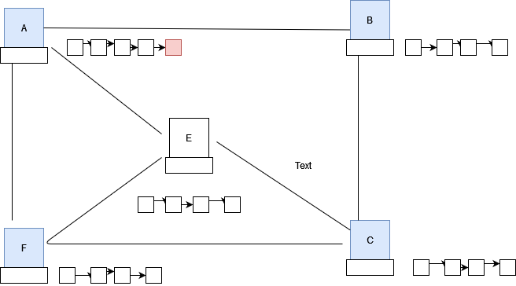
Cont.

Slide 6
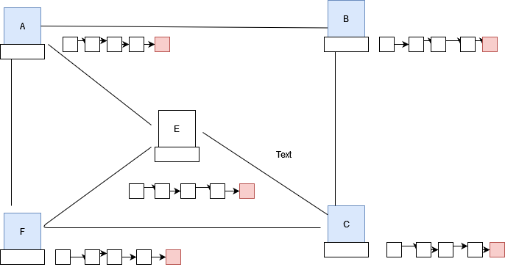

Slide 7
Application of blockchain
Product Tracking-Denmark super market,Walmart
Smart Contract- it’s a program like java,python.in blockchain we use solidity
International wire transfer- can use in the banking system.(jp morgan already use blockchain in their banking system)
Health care system-

Slide 8
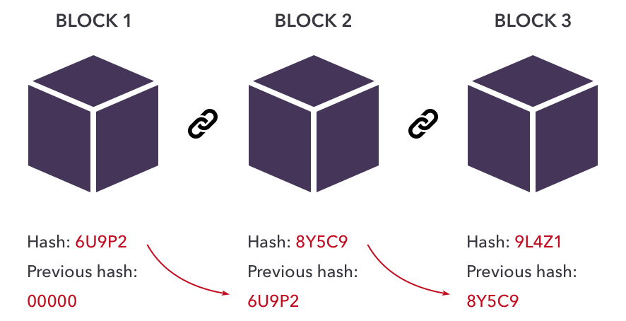
Hashing Algorithm
In a blockchain there are number of blocks and each block is attach to another block.so its very important to one block is identify its subsequent block.thats why we need a hash so that we can identify the block.

Slide 9
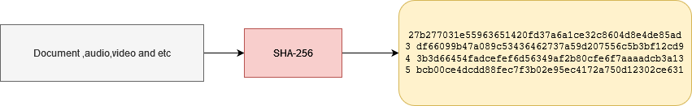
Cont.
Hash is like fingerprint, as we know that different people has different fingerprint ,the same way different block has different hash number.
We can generate the hash through SHA-256 algorithm
This has 64 hex char
each char is of 4 bits so in total 64*4=256 bits

Slide 10
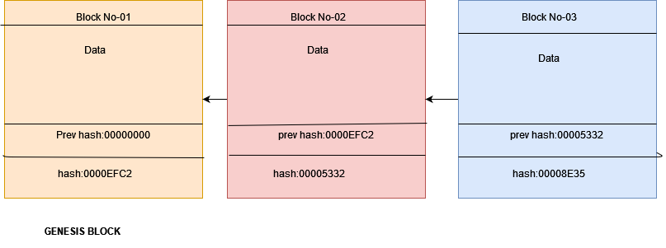
Cont.

Slide 11
Cont.
5 requirements of Hash Algorithm:
One way
Deterministic
Withstand collision
Fast computation
Avalance effect
https://passwordsgenerator.net/sha256-hash-generator/

Slide 12
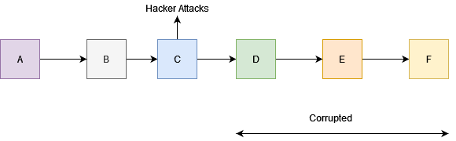
How Blockchain will be immutable
If hacker tries to hack C block so its hash will be changed because of avalanche effect and as D block is depended on C block( D’s prev has is stored in C’s hash) so D will block will be corrupted and E and F also be corrupted.

Slide 13
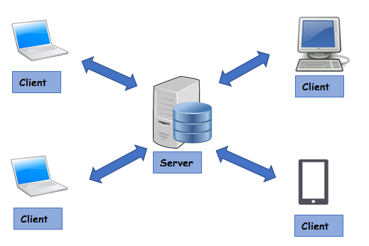
Centralized Network vs P2P network
Centralized Network: client server model.(banking system where there is a central server and customers are treated as a client)
Easy to hack cause all the data stores on one single server.

Slide 14
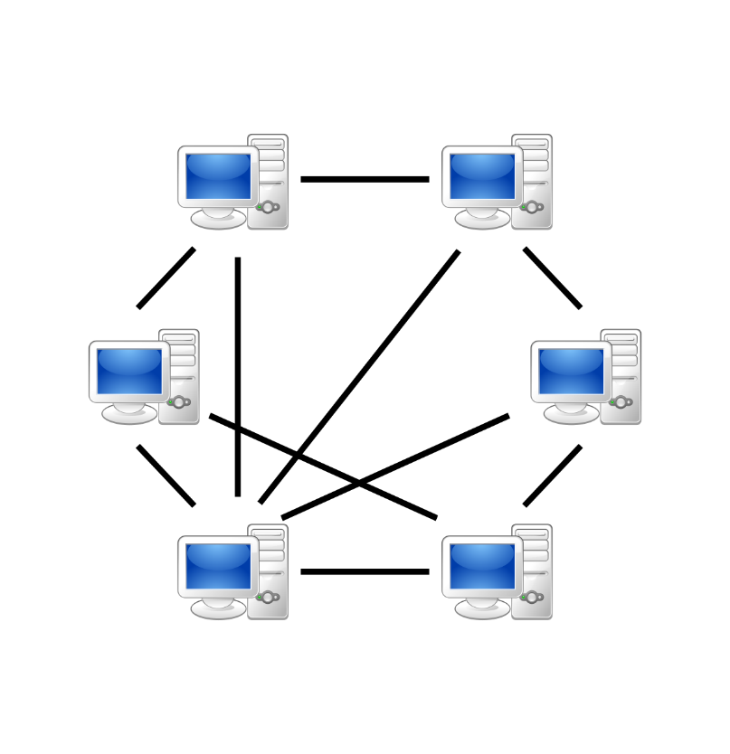
Distributed p2p network
In distributed network every node is connected to each other so any node can take data from anyone even if any node get hacked and corrupt the data , others node can get data from anothers node. This is the biggest advantage of distributed p2p network.

Slide 15
Distributed p2p network in blockchain
In distributed p2p network there is no client server and blockchain uses this network.
we can recover our corrupt data
using this distributed p2p network.

Slide 16
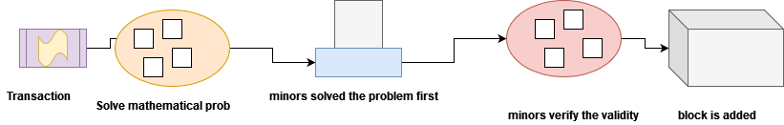
Blockchain Mining
As there is no central authority so trust and security environment will be created through blockchain mining.
Transaction stores on a mempool and from there group of minors pick this transaction and try to add this in a block.

Slide 17
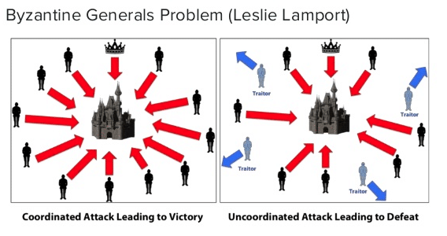
Byzantine Generals Problem
Byzantine Fault Tolerance
each general has its own army and that each group is situated in different locations around the city they intend to attack. The generals need to agree on either attacking or retreating. It does not matter whether they attack or retreat, as long as all generals reach consensus, i.e., agree on a common decision in order to execute it in coordination.
It will work what majority say.66% majority will be needed.

Slide 18
Consensus Protocol
Consensus protocol protects us in two way
1.Prevent attacks
2.Competing chain problem
Types of Consensus protocol:
1.Proof of work(POW)
2.Proof of stake(POS)
3. PBFT (Practical Byzantine Fault Tolerance)
4. DAG (Directed Acyclic Graph)

Slide 19
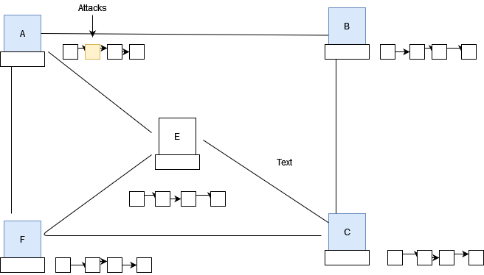
Cont.( attack middle node)

Slide 20
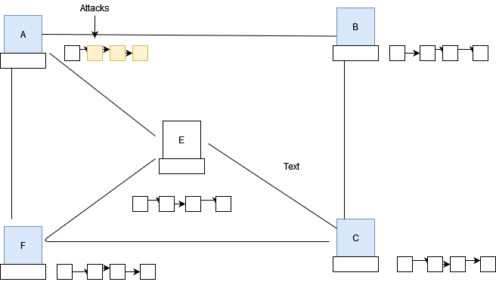
Cont.

Slide 21
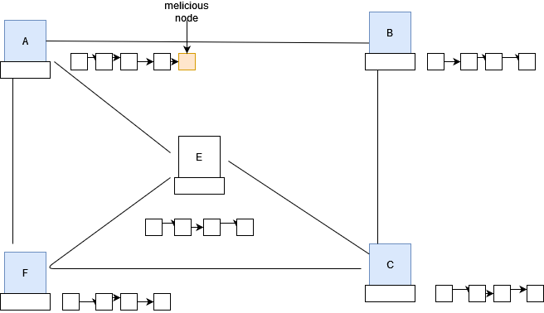
Cont.(attack last node)
But if one node suppose A don’t touch any middle node ,it will try to add malicious node at the last then how we will deal this situation?
We can deal this problem
Using consensus protocol.
Minor always try to add right
Block otherwise he will get
Punishment and will not get
Any reward.
Note:mining takes time but
Verify will not take more time.

Slide 22
Cont.
proof of work(POW):
Blockchain is a consist of lots of nodes or miner.if we want to add new block in the network ,then miner have to solve the mathematical equation and which miner solve it first is called POW.if 50% up nodes or miner validate it then new block is added to the network.
Concern:-i)lots of energy usage cause only one miner solve it but rest of them are trying butcan’t solve but as their energy is usage which is completely waste
.ii) if more miners collaborate with one another and try to solve the puzzle then51% attack can be happen which is bad for the decentralized
proof of stake(POS)
proof of stake solves the proof of work’s problem. Here one node is randomly chosen who will only mine and solve the mathematical puzzle. Here its called a validator. To become a validator, a node has to deposit stake. If the stake size is big then it has agreat chance of mining. Validator loses stake if they approve fraud transaction.

Slide 23
Longest Chain Rule (Competing Chain Problem)
AEFBC this node/minor has same copy of blockchain.

Slide 24
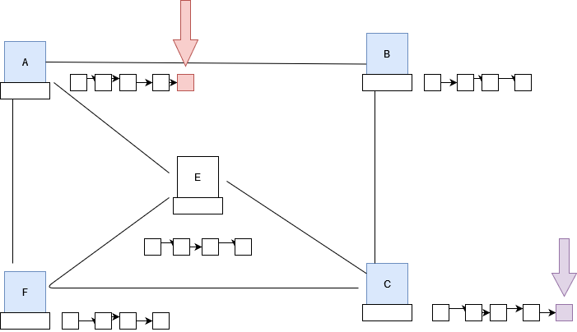
Cont.
A and C is a minor so it will mine a block at a same time and add a block in the blockchain and then A and C pass the information all over the network.

Slide 25
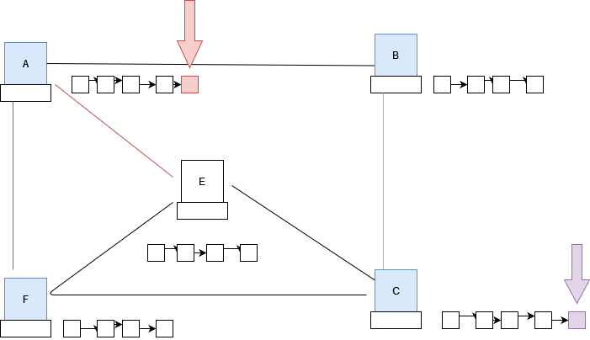
Cont.
A transfer the information to E and F and C transfer the information to B. cause E and F close to A and B is close to C.

Slide 26
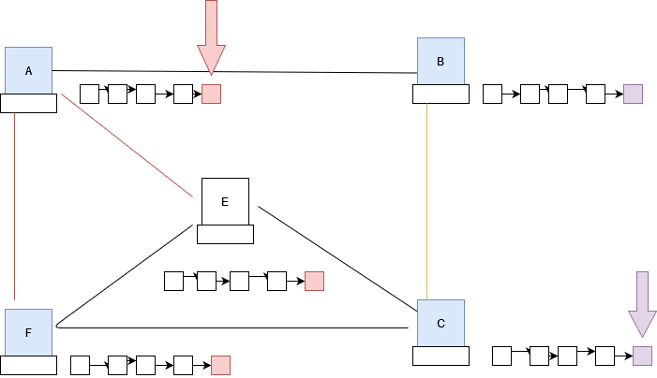
Cont.
Then E and F verify the block is ok or not and add this block to their blockchain and B does the same thing.

Slide 27
Cont.
Then conflict will start cause AEF has different set of blockchain and BC has different set of blockchain.
Now how we can solve this issue ?
Consensus protocol tells us that if we have two different set of blockchain then we accept that blockchain which network has longest blockchain.
In this figure neither AEF will add the purple color block in their blockchain nor BC add the red color block in their blockchain. They will wait for a while to see which network add another block first.
Assume that AEFBC all has same computation power so AEF will be more powerful than BC cause AEF has 3 node and BC has only 2. so AEF add a new block in their blockchain and then they have total 6 blocks in their blockchain and BC has only 5 blocks in their blockchain so BC have to change their blockchain and follow and accept the AEF’s blockchain.

Slide 28
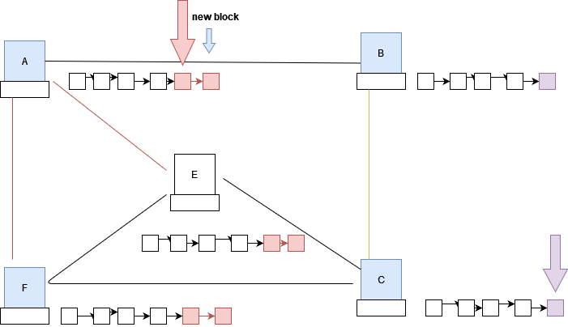
Cont.
Add a new block in the AEF blockchain

Slide 29
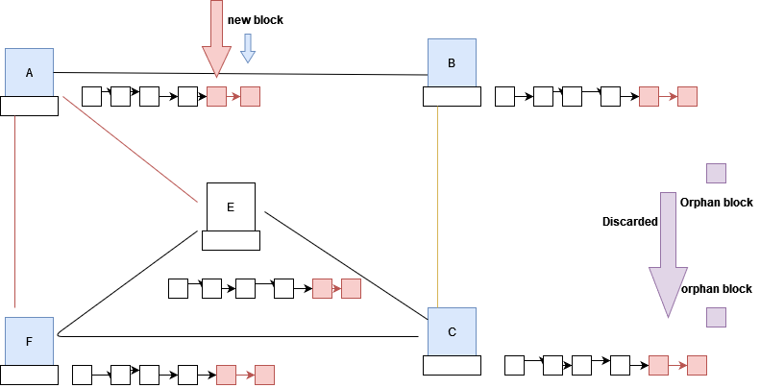
Cont.
As AEF has longest blockchain so BC have to discard their purple blocks and accept the red blocks and thus way the total AEFBC has the same copy of blockchain.

Slide 30
Cont.
The consensus protocol is much better than the byzantine fault tolerance. Consensus protocol needs 51% majority to add the blocks in the blockchain where byzantine needs 66% majority.
All the transaction in the orphan block will be dropped and the miner that had mined will not get reward.
That’s why ,when we do the transaction ,have to wait until 5 more blocks will be added otherwise double spending will be occurred.

